Slide 1
Lost And Found
Group Members
Sidra Shafique(095)
Memoonah(078)

Slide 2
About Lost And Found
we will implement the following features and functionalities:
- User Registration and Authentication
- Lost Item Reporting
- Found Item Posting with Photo Upload
- Ownership Verification Questionnaire
- Search and Filter Functionality
- Notifications for Updates

Slide 3
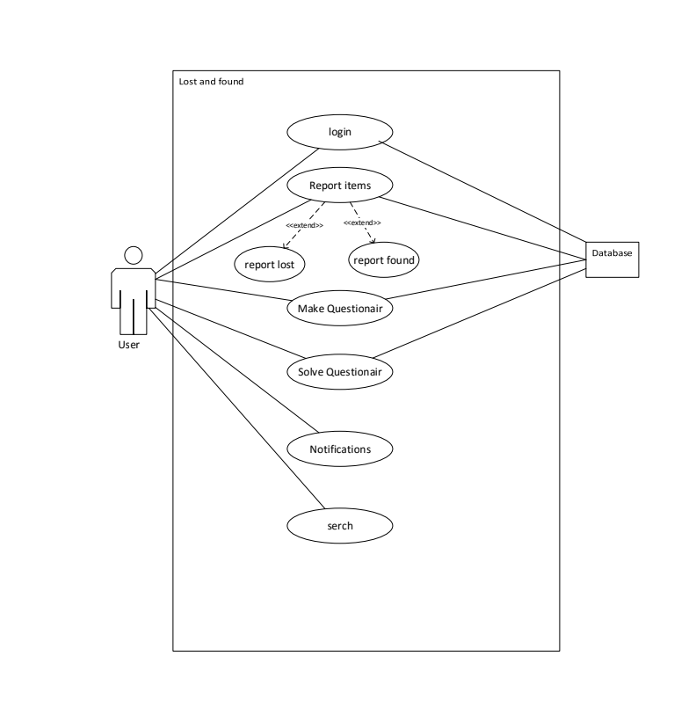
Use Cases

Slide 4
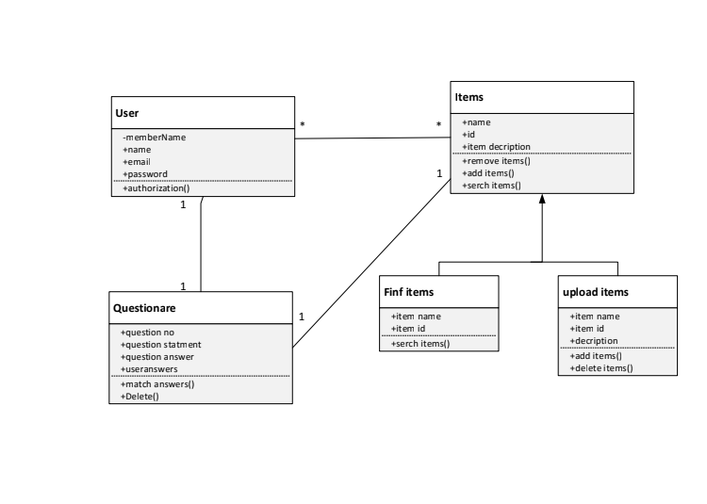
Class Diagram

Slide 5
Problem statment
Problems Now:
It's hard to find lost things.
People argue about who owns what.
Talking is not easy.
What We Want:
Make finding things easier.
Stop fights over who owns what.

Slide 6
Nfrs
Make things fast.
Show everything clearly.
Make sure people really own stuff.
Let people talk easily. (Through Questionnaire & email)

Slide 7
Our Development Stack
React js with tailwind css/Material UI.
Backend : express js

Slide 8
Work division
for now while working on login page
Memoonah: backend
Sidra Shafique : frontend

